Slide 1
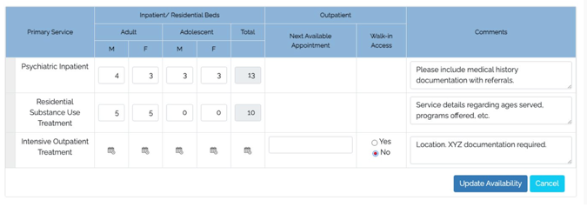
Updating Service Availability
Upon log-in, first screen to appear
Quickly & easily update availability by adjusting bed counts & clicking “Update Availability”
Ability to include specific comments related to service

Slide 2
Updating Operational / Licensed Bed count
Navigate to Name drop-down menu at top right, and choose “Service Administration”
Click on Primary Service type (will need to complete for each Primary Service type)
Scroll to middle of page for “Individual Service Bed Count”
Enter # of Operational Beds and # of Licensed Beds
Licensed Beds:
Total licensed beds for this service/location
Number of beds that the facility is licensed by the state to maintain
Operational Beds:
Total operational beds for this service / location
Number of beds that can accept patients; differs from the number of beds available and can be variable based on circumstances.

Slide 3
Treatment Connection
Enable via “Service Administration” under name drop down menu on top right-hand side of screen
Click on Primary Service type
Scroll down to the middle of the page and click on:
”Check this box to display your service on the Treatment Connection website.”
Enter information in provided boxes
General public inquiries will flow into OpenBeds in the Referral Request status tab

